Slide 1
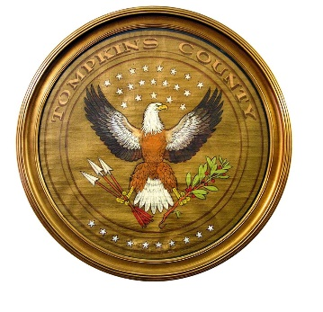
Tompkins County
Highway
2020 Budget Presentation

Slide 2
Recommended Budget
Highway
 | 2019 Modified | 2020 Recommended | $ Change | % Change
Expenditures | $7,622,961 | $7,762,357 | $139,396 | 1.83%
Revenues | -$7,622,962 | -$7,762,357 | -$139,395 | 1.83%
Net Local | -$1 | $0 | $1 | -100.00%
Highway Machinery
 | 2019 Modified | 2020 Recommended | $ Change | % Change
Expenditures | $2,143,218 | $1,957,714 | -$185,504 | -8.66%
Revenues | -$1,738,219 | -$1,893,714 | -$155,495 | 8.95%
Net Local | $404,999 | $64,000 | -$340,999 | -84.20%

Slide 3
Major Influences
Working to provide the same Level of Service to Taxpayers while maintaining a Safe, Reliable, Efficient Fleet of Vehicles and Equipment causes OTR request above target.
Public Works Apprenticeship Program

Slide 4
Full-Time Equivalents
Highway
2017 | 2018 | 2019 | 2020 Target | 2020 Rec. | # Change | % Change
35.94 | 35.94 | 35.94 | 35.94 | 40.44 | 4.5 | 12.5%
Highway Machinery
2017 | 2018 | 2019 | 2020 Target | 2020 Rec. | # Change | % Change
6.0 | 6.0 | 6.0 | 6.0 | 6.0 | 0 | 0%

Slide 5
Over-Target Requests Supported by the Recommended Budget
Highway
Page # | OTR # | Priority | Req. OTR | Req. Source | Rec. OTR | Rec. Source | Purpose
4-97 | 51 | 3 | $44,000 | One-Time | $44,000 | One-Time | Public Works Apprenticeship Program
Page # | OTR # | Priority | Req. OTR | Req. Source | Rec. OTR | Rec. Source | Purpose
4-117 | 85 | 1 | $44,000 | One-Time | $44,000 | One-Time | Interfund Distribution

Slide 6
OTR # 51 Public Works Apprenticeship Program is a shared initiative between Tompkins County, City of Ithaca and Town of Ithaca. The goal of this initiative is to create opportunity for individuals that have interest in Public Works Career. This OTR creates both a continuation and expansion of this program. The County completely funds the 6 positions and is then reimbursed by City/Town 1/3 each.
A corresponding increase in the General Fund's "Contribution to the D-Fund" unit (9522, in the Interfund Distribution section of the Budget) is required. OTR #85
OTR amount of $44,000

Slide 7
Highway Machinery
Page # | OTR # | Priority | Req. OTR | Req. Source | Rec. OTR | Rec. Source | Purpose
4-101 | 48 | 1 | $64,000 | One-Time | $64,000 | One-Time | Replace Four Pickup Trucks
Page # | OTR # | Priority | Req. OTR | Req. Source | Rec. OTR | Rec. Source | Purpose
4-101 | 49 | 2 | $100,000 | Target | $100,000 | Target | Road Side Mower
Page # | OTR # | Priority | Req. OTR | Req. Source | Rec. OTR | Rec. Source | Purpose
4-117 | 97 | 2 | $100,000 | Target | $100,000 | Target | Interfund Distribution

Slide 8
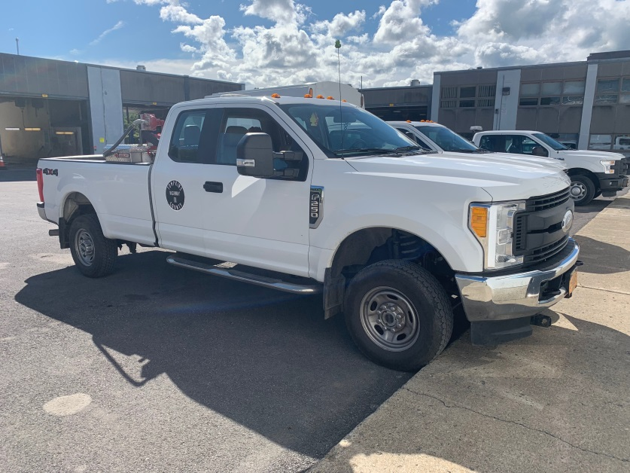
OTR # 48 Highway Division in an effort to keep up with the divisions long range Equipment Replacement Plan is requesting 4 Supervisor Pickup Trucks. Total Cost is estimated to be $164,000 with a Trade Value of $100,000.
OTR amount of $64,000

Slide 9
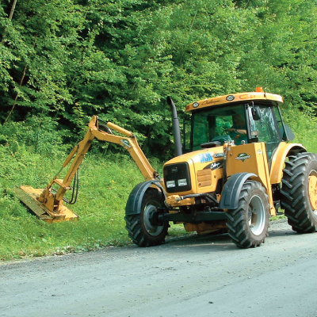
OTR # 49 This OTR requests $100,000 in Target funding to replace a Road Side Mower. This is the last of 3 mowers in the scheduled replacement cycle. The County purchased 3 mowers in 2008, and, rather than replace them all in one year, their replacements have been staggered over the last few years.

