Slide 1

Tompkins County
Planning and Sustainability
2020 Budget Presentation

Slide 2
Recommended Budget
 | 2019 Modified | 2020 Recommended | $ Change | % Change
Expenditures | $1,900,040 | $1,394,360 | -$505,680 | -26.61%
Revenues | -$796,950 | -$362,861 | $434,089 | -54.47%
Net Local | $1,103,090 | $1,031,499 | -$71,591 | -6.49%
Grants that show up in 2019 budget, but not in 2020 = $372,350
  Resiliency and Recovery Plan, Cayuga Lake Blueway Trail improvements, Electric Vehicle purchase support
Department electric vehicle purchase in 2019: $35,800
Municipal Parks and Recreation Grant Funds: $50,000

Slide 3
Major Influences
Energy, Climate Change, Adaptation
  Net-zero emissions - electrification of heating, cooling, transportation
  Natural disasters - especially for flooding, drought
Affordable Housing and Focused Development
  Housing for homeless to moderate income near jobs/services
  Ability for businesses to recruit and retain workforce
Water Quality: Harmful Algal Blooms and Cayuga Lake TMDL
  Protect recreational amenities and public water systems
Tourism
  Increasing visitor-nights in off-season and supporting attractions

Slide 4
Full-Time Equivalents
2017 | 2018 | 2019 | 2020 Target | 2020 Rec. | # Change | % Change
8.82 | 10.70 | 10.70 | 9.70 | 10.70 | 0 | 0
Requesting target funding for Senior Planner – Energy Specialist

Slide 5
Over-Target Requests Supported by the Recommended Budget
Page # | OTR # | Priority | Req. OTR | Req. Source | Rec. OTR | Rec. Source | Purpose
4-151 | 24 | 1 | $101,310 | Target | $101,310 | Target | Business Energy Advisors Program
 |  |  | -$55,000 | One-Time | -$55,000 | One-Time
4-152 | 25 | 2 | $30,000 | One-Time | $30,000 | One-Time | Municipal Housing Affordability Infrastructure Grant
4-152 | 26 | 3 | $10,000 | One-Time | $10,000 | One-Time | Southern Tier 8 Membership Dues

Slide 6
OTR 24: Business Energy Advisors Program (Budget Book p. 151)
Request
Not requesting year 3 of the 3-year OTR ($50,000)
Requesting $46,310 in target as step 1 of a 2-step process for full target funding in 2021
$101,310
-$55,000
$46,310
Account | Amount | Type
42070 CONTRIB FR PRIV AGENCIES TCAD for Consultants | $ -35,000 | One Time
43959 STATE AID PLANNING NYSERDA Grant to Offset 2020 Target Cost | $ -55,000 | One Time
51000679 SR PLANNER-ENERGY SPEC | $ 62,962 | Target
58800 FRINGES | $ 30,133 | Target
54400 PROGRAM EXPENSE | $ 1,815 | Target
54442 PROFESSIONAL SERVICES TCAD to Consultants | $ 35,000 | One Time
54442 PROFESSIONAL SERVICES | $ 6,400 | Target

Slide 7
OTR 24: Business Energy Advisors Program
Goal
Decrease GHG emissions from businesses and County government
Predictability for businesses and staff
In addition to BEA:
  Assist with County projects (e.g., airport geothermal RFI)
  Assist the County in achieving its vision for net-zero emissions

Slide 8
OTR 24: Business Energy Advisors Program
Progress Report
NYSERDA grant goal was to conduct energy charrettes for 30 businesses by end of 2020
63% of goal achieved by end of first full year (Aug 2019)
Positive reviews from participating businesses
“Our participation in the BEA program was transformational for our project – it enhanced both the energy and financial performance of the building.”
“With the help of [the BEA team], we took another look at our design, budget and associated grants. We believe our current design is friendlier to our environment based on the changes we have made.”

Slide 9
OTR 25: Municipal Housing Affordability Infrastructure Grant (Budget Book p. 152)
Request
Last year 1-year OTR using $45,000 of rollover
Continue as year 1 of a 3-year program through 2022
Includes $20,000 of rollover funds for 2020
Predictability for municipalities that funding will be available
After 2022, assess the program to determine impact on affordable housing

Slide 10
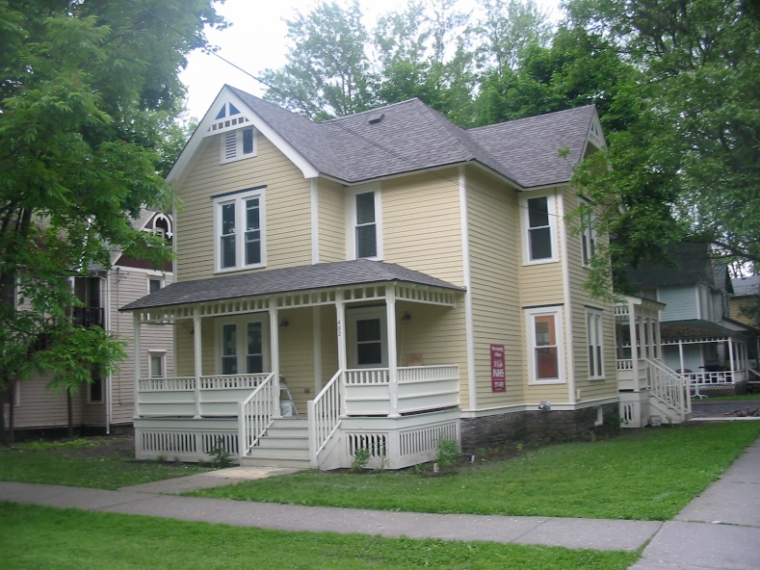
OTR 25: Municipal Housing Affordability Infrastructure Grant
Goal
Assist municipalities pursuing efforts to support housing affordable to County residents
Encourage collaboration and partnership between the County and municipal governments
Increase the amount of affordable housing
Improve and maintain existing housing
Assist infrastructure needs in nodes

Slide 11
OTR 25: Municipal Housing Affordability Infrastructure Grant
Progress Report
Since March 2019, two projects have been funded:
  Town of Lansing nearly contracted with a consultant
    Town Center Traffic Study – a multimodal transportation impact assessment for a full buildout of the Town owned land that will be incorporated into a GEIS for the whole area to streamline approval for all future projects ($10,000)
  Village of Dryden hired a consultant
    Surveying housing conditions in preparation for submitting a CDBG Rehab application when they are announced this fall ($5,000)

Slide 12

OTR 26: Southern Tier 8 Membership Dues (Budget Book p. 152)
Request
Year 3 of 3-Year OTR: In 2018 County re-joined the Southern Tier 8 Regional Board (ST8) with understanding that it was for a 3-year period with evaluation in year 3
Annual dues are $10,000
Monthly meetings with other planning directors
If funded, next year will do an assessment to determine the impact of membership

Slide 13
OTR 26: Southern Tier 8 Membership Dues
Goal
Increase collaboration with regional partners in support of Comprehensive Plan’s overarching principle
ST8 operates under joint resolution of legislative bodies of member counties: Broome, Chenango, Cortland, Delaware, Otsego, Schoharie, Tioga and Tompkins
ST8’s 5-Year Plan Goals
  Develop Regional and Local Economic Development Strategies
  Create a region where individuals have the opportunity to improve their employment status
  Address Infrastructure Deficiencies
  Adopt Regional Marketing Strategies
  Create Innovative Approaches to Community Well-Being Issues
  Develop Strategies to Focus on Our Small, Rural Communities

Slide 14
OTR 26: Southern Tier 8 Membership Dues
Progress Report
Participating on steering committee for Energy Infrastructure Assessment and Strategy for all eight Counties
Informative workshops (Southern Tier Industry Summit; Agriculture and Food Industry Summit)
Town of Newfield, Groundswell Center for Local Food and Farming, and Cornell Cooperative Extension of Tompkins County were all approved for Appalachian Regional Commission (ARC) Area-wide Grants funding from 2018 applications (total $234,481)
In 2019 helped 3 TC applicants compete for funding for ARC grants

Slide 15
Over-Target Requests NOT Supported by the Recommended Budget
Page # | OTR # | Priority | Req. OTR | Req. Source | Rec. OTR | Rec. Source | Purpose
4-153 | 27 | 4 | $10,000 | One-Time | $0 | One-Time | Advisory Board Priorities

Slide 16
OTR 27: Advisory Board Priorities (Budget Book p. 153)
Goal
Support activities of advisory boards appointed by the Legislature
Request: New 1-year OTR - There are two parts to this OTR:
  1. EMC Climate Action Committee ($2,000) to conduct public education on environmental matters
    Print brochures to promote steps that can be taken by residents, farms, and small businesses to ameliorate and control flooding and to adopt carbon-sequestration practices
  2. WRC Clean Boating Map ($8,000) to design and print 2,000 copies of a map of Cayuga Lake showing boating services and information on clean boating techniques to reduce contamination and spread of invasive species
    Legislature funded as OTR in 2019. In case they cannot complete this work in 2019, they have requested these funds be available to them in 2020

Slide 17

Tourism Program Budget
Local Law No. 4-1989 Authorizes the County to collect Hotel Room Occupancy Tax
100% of program revenue comes from that tax
All grant awards require legislative approval
Proposed budget approved by Strategic Tourism Planning Board each July
No Over Target Requests

Slide 18
Tourism Program Budget
 | 2019 Modified | 2020 STPB Recommended | $ Change | % Change
Expenditures | $3,081,649 | $3,033,153 | -$48,496 | -1.57%
Revenues | -$2,935,000 | -$3,050,760 | -$115,760 | 3.94%
Use of/Addition to Reserves | -$146,649 | $17,607 | $164,256 | 112%
Net Local | $0 | $0 | $0 | 0%
Expenditures include:
$544,069 – Other allocations (Budget Book p. 34)
  Administering the room tax – County allocated10%
  TCAD - general operating support
  Planning and Sustainability staff support
$2,489,084 – Tourism Promotion (Budget Book p. 194)
2018 STPB set a policy to maintain a 5% reserve balance
$544,069
+$2,489,084
$3,033,153

Slide 19
Revenue – Room Tax
2020 Forecast of $3,050,760 Room Tax revenue
4% increase compared to 2019 Forecast
Notes:
Forecast includes analysis of industry trends, forecast of new hotel rooms, and corrections for abnormal events (i.e. Maplewood resident displacement). Data from Smith Travel Reports used to analyze hotel sales trends.

Slide 20
Expenditures – Room Tax
STPB uses 60/40 policy:
  Marketing 60%
  Product Development 40%
Forecast $183,000 contribution to general fund
Notes:
Other includes
Program Director Wages & Benefits
TCAD General Operating Support
STI Grants
Contribution to Reserves

Slide 21

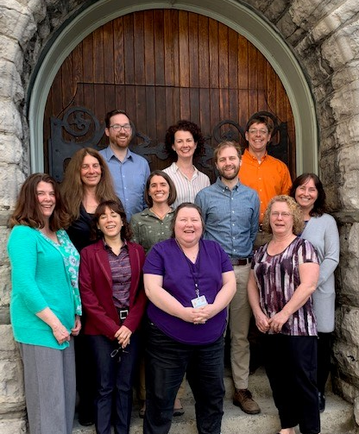



Thank you for your support!

