Slide 1
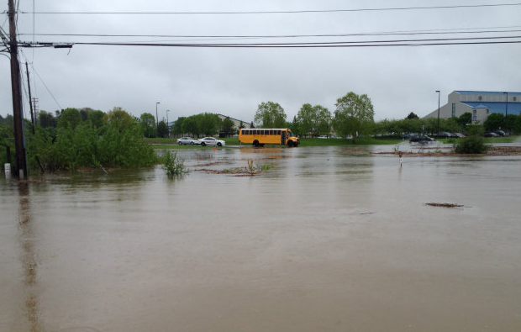
Flood Resiliency
Sharon Anderson, CCE-Tompkins
Environment Team Leader
Flooding near the East Hill Plaza. Photo: WHCU/Photo by Lee Rayburn

Slide 2
1. Capacity of road culverts under current and future climate conditions
Stream connectivity
Notes:
This project would have immediate benefits and also was a practical, tangible way for communities to take a step toward climate adaptation

Slide 3
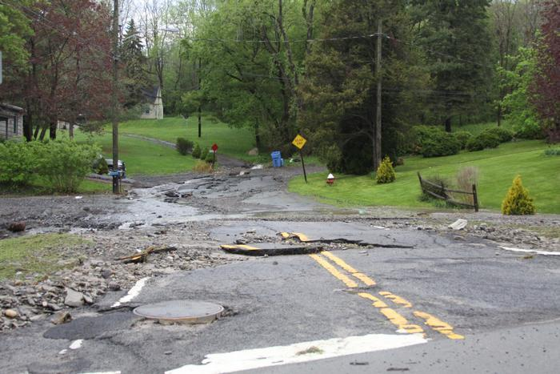
Grant Ave. in Penn Yan May 2014. Photo by Greg Cotterill, Finger Lakes News Radio
Notes:
Many aspects of flooding.
Road damage is costly, cut off access to hospitals, emergency shelter,
back up water that causes damage to other structures
That work is the focus of this presentation.
Before – touch on other work around flood resiliency

Slide 4
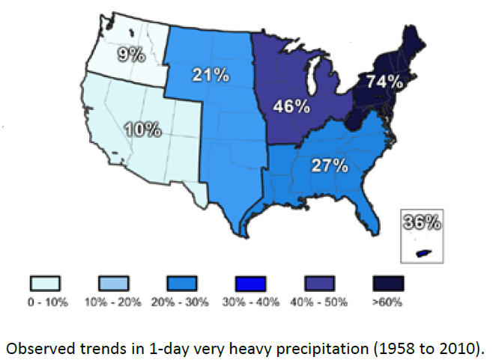
NYSDEC
NYSDEC ClimateSmartCommunities
Notes:
What you all know:
Increased in very heavy precipitation, increase in amt of rain of 100 year storm
Given the opportunity to do something around climate adaptation with funding through TCCPI & CCETC
--what are others doing?
Learned of work in the Hudson Valley, involving Todd Walter and Becky

Slide 5
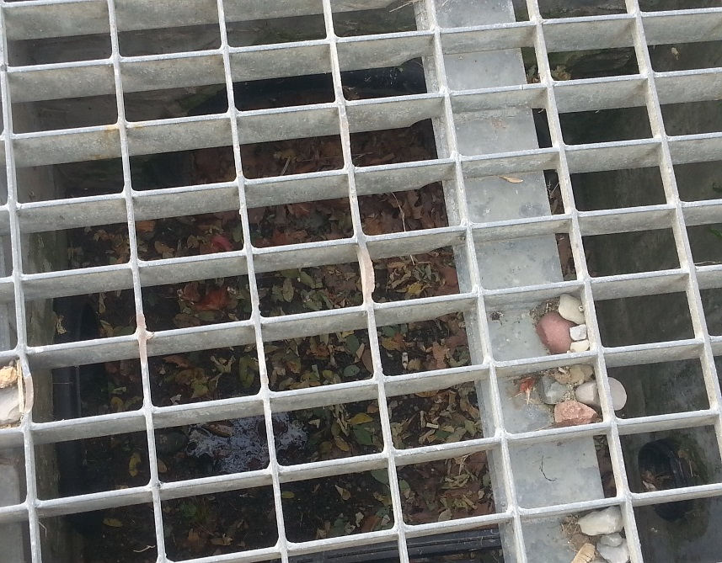
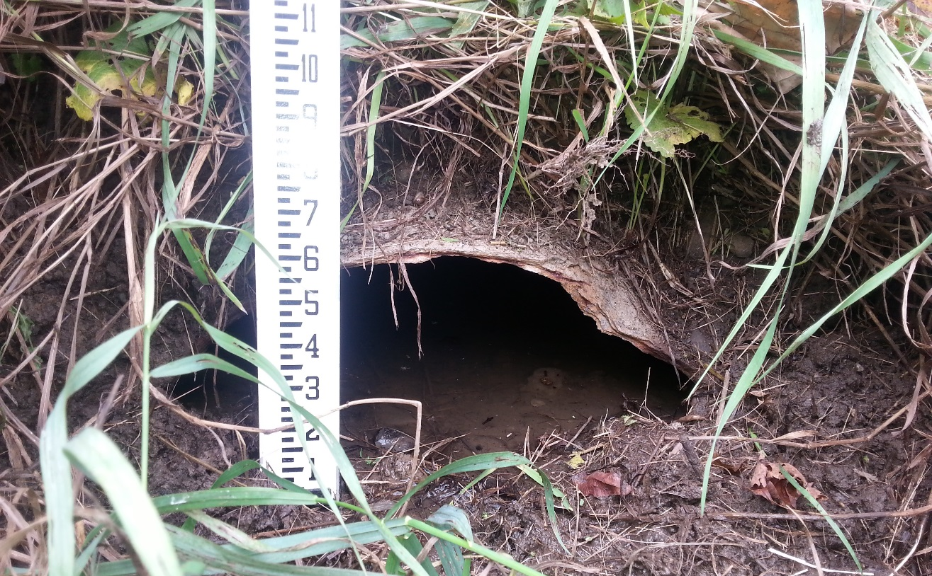
NYS: ~ 1 million culverts
Lack of inventory* of locations, sizes, conditions of culverts and catch basins
*except Town of Ithaca
Notes:
According to NYSDOT and NYSDEC
EXPECTION: Town of Ithaca

Slide 6

Runoff to each culverts
rain ->
Culvert
infiltration ->
runoff
saturated
areas
Notes:
Some rain infiltrates, some runs off

Slide 7
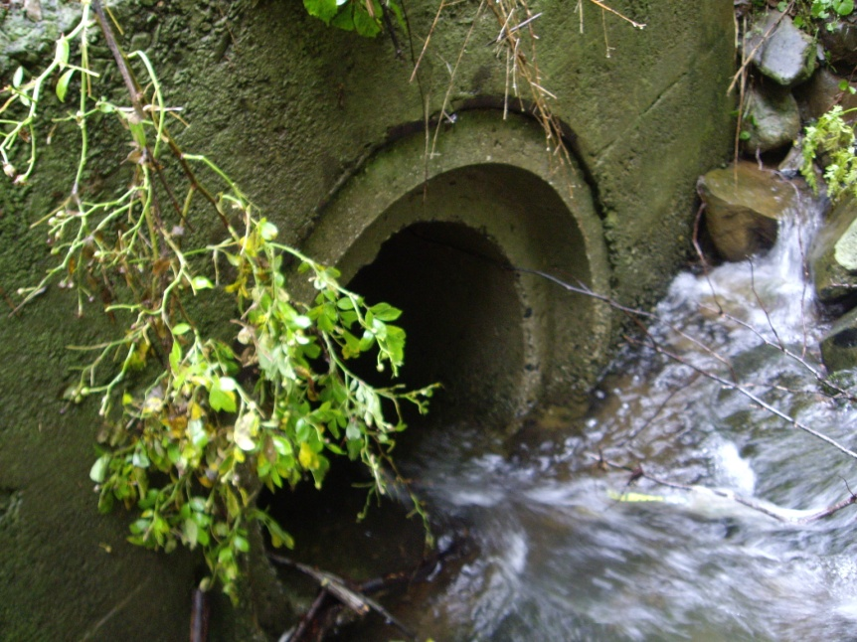
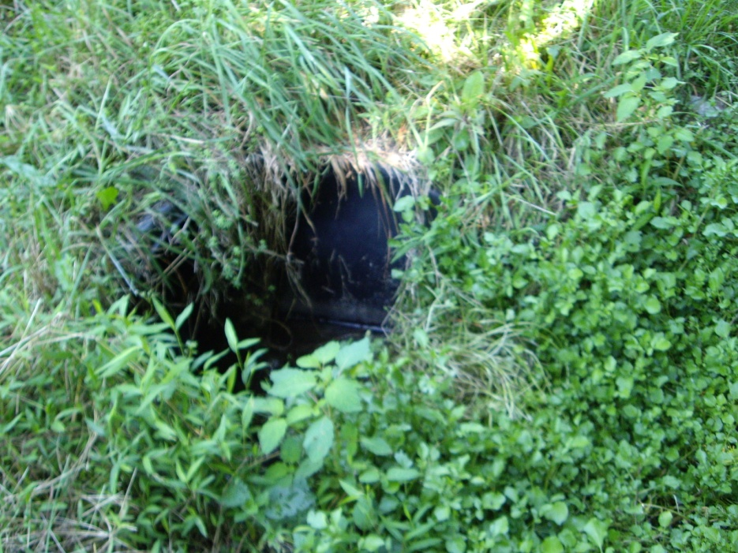
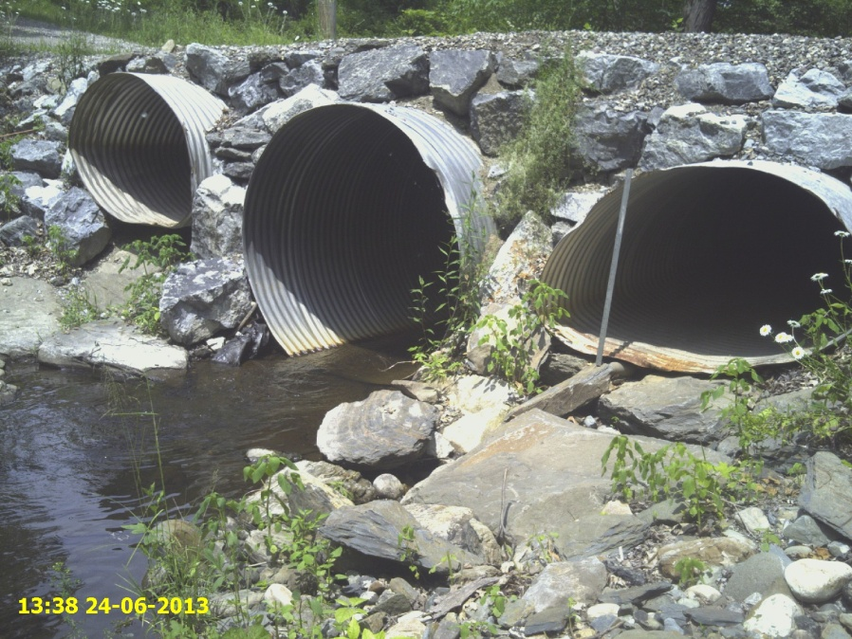
Culvert properties
Size (diameter)
Shape
Materials
Slope
Stream or ditch conditions

Slide 8

100-yr flood
has a 1 percent chance of occurring in any given year.
if you calculate the actual probability, “there’s a 64 percent chance you’re going to see something bigger than that in the next 100 years,” Tufts hydrologists Richard Vogel

Slide 9
Computer model
Capacity of each culvert compared to culvert watershed
Repeated for predicted 2050 precipitation
Notes:
No perfect culvert size. Size based on road use

Slide 10
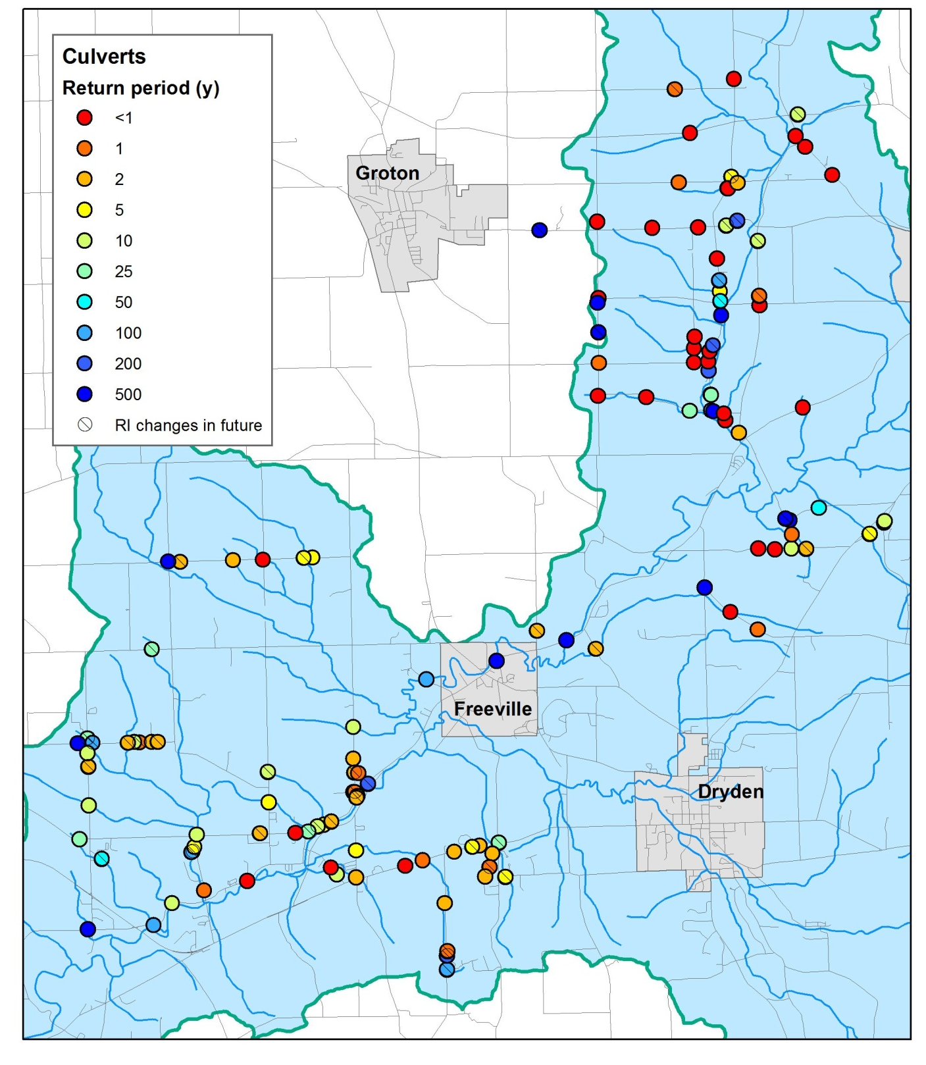
Results: map of culverts

Slide 11
Relative capacity of Fall Creek culverts
Return period (y)

Slide 12
Highway staff to review and prioritize
Culverts blocked or already undersized
Culvert “adequate” now that will overtop the road with increased precipitation
Design new culverts for future precipitation conditions

Slide 13
MS4s
Sewershed mapping compliance

Slide 14
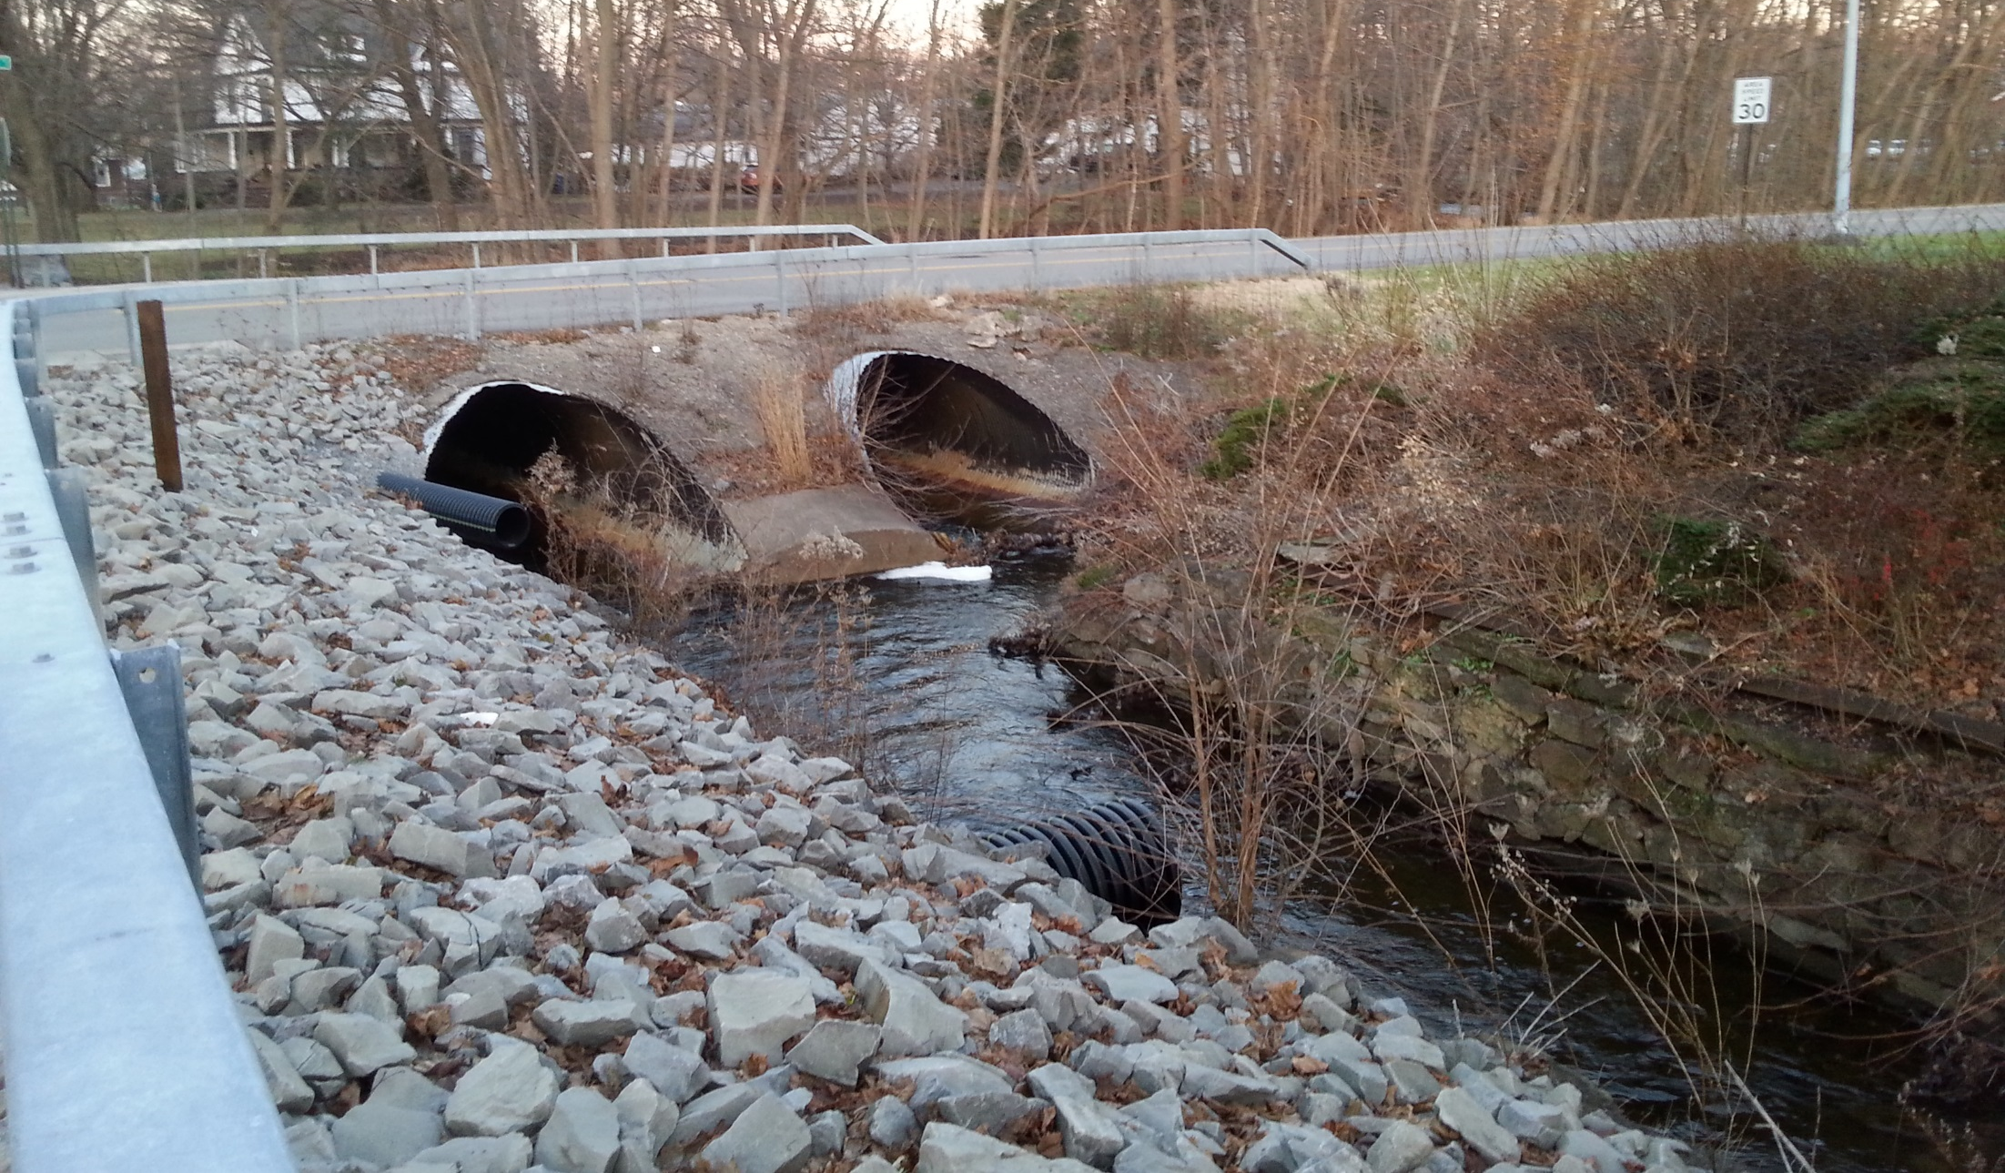
2. Stream Connectivity
Notes:
Work with the tools Becky created
Another grad student continuing her work
Field check some of the Fall Creek data
Select some other watersheds
Provide the information to municipalities
The information prioritizes culverts for more indepth study
NYSDEC & WRI web based tool in ~ 2 years

Slide 15
North Atlantic Connectivity project
NYS DEC: support and possible WQIP funding for replacing culverts

Slide 16
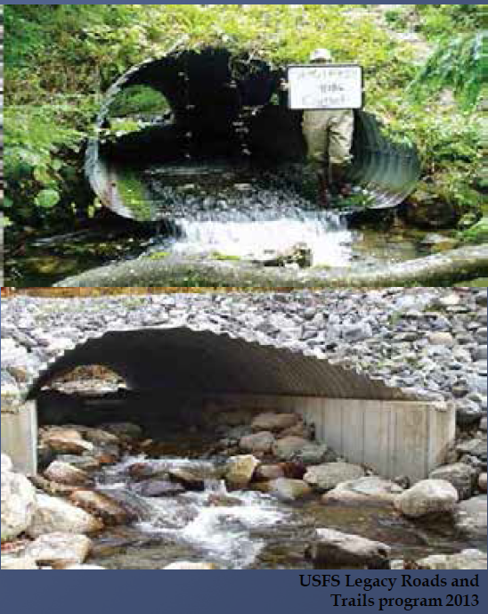
USFS Legacy Road and Trails Program 2013.
New culverts
survived Irene
Notes:
Per NYSDEC, culverts replace thru this program survived Irene

Slide 17
Timeframe
2014 Proof of concept
2015 Field work added stream connectivity. Funding secured for Tompkins County
2016 and 2017 field work
2018 Final number crunching, analysis, GIS online done

Slide 18



