Slide 1
TCCOG DISCUSSION
June 22, 2017
EMS in TOMPKINS COUNTY

Slide 2
ALL CALLS DISPATCHED
2006
49,537
2016
66,226

Slide 3
CALLS DISPATCHED PER DISCIPLINE
LAW 34,315 45,149
FIRE 4,436 5,017
EMS 10,786 16,060

Slide 4
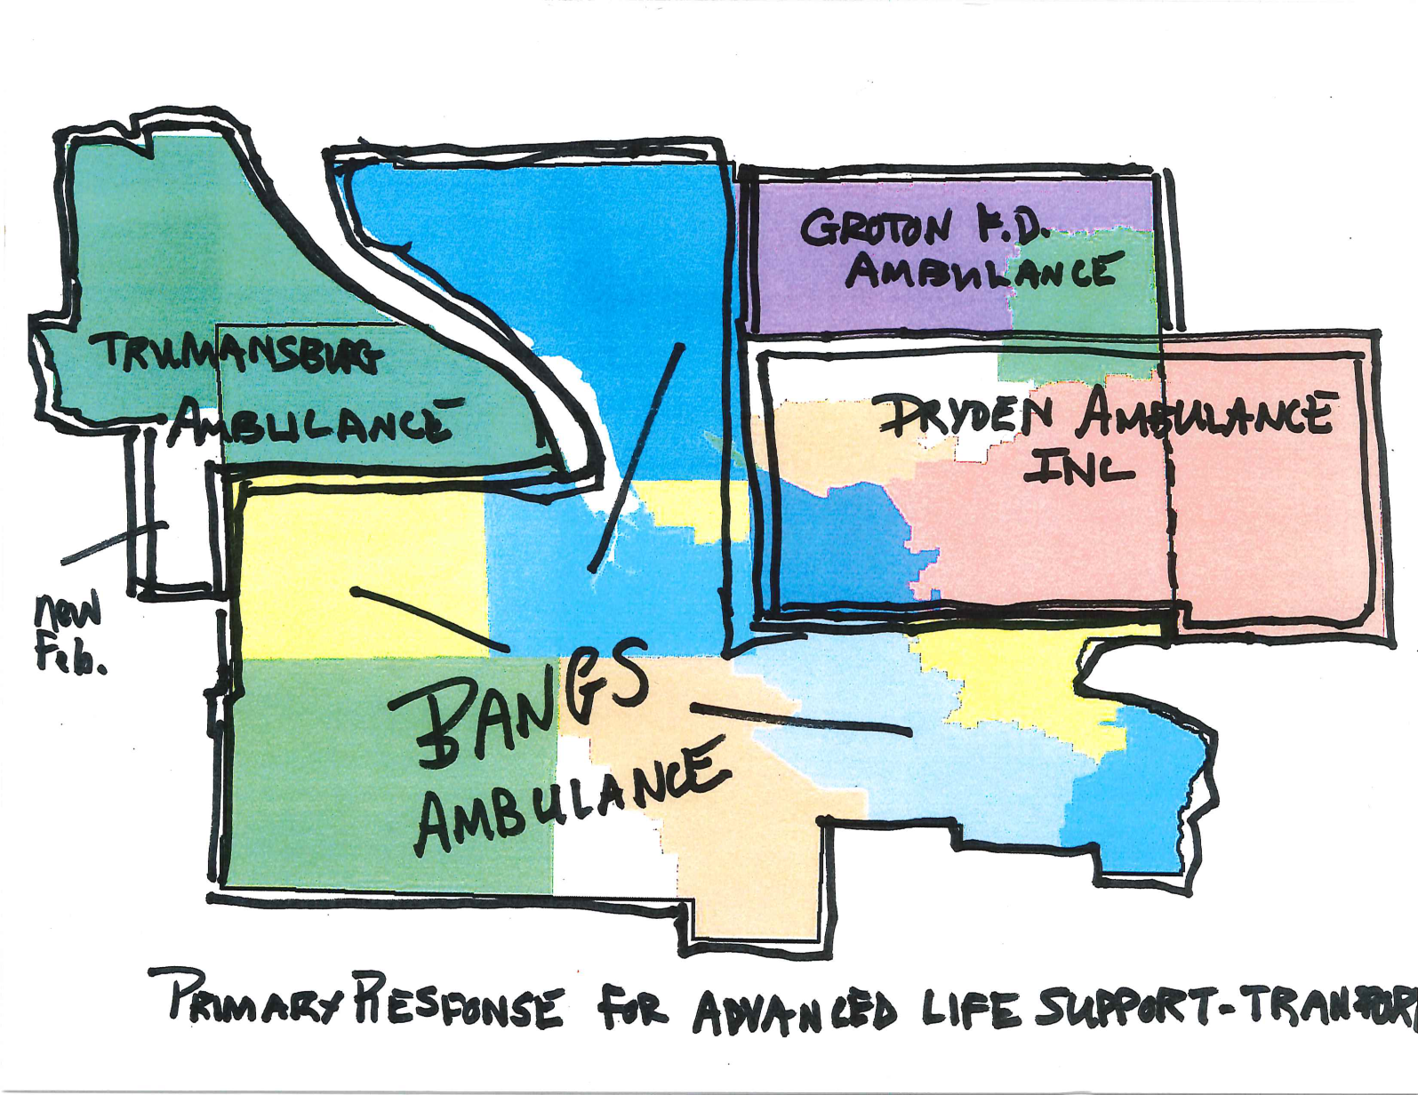

Slide 5
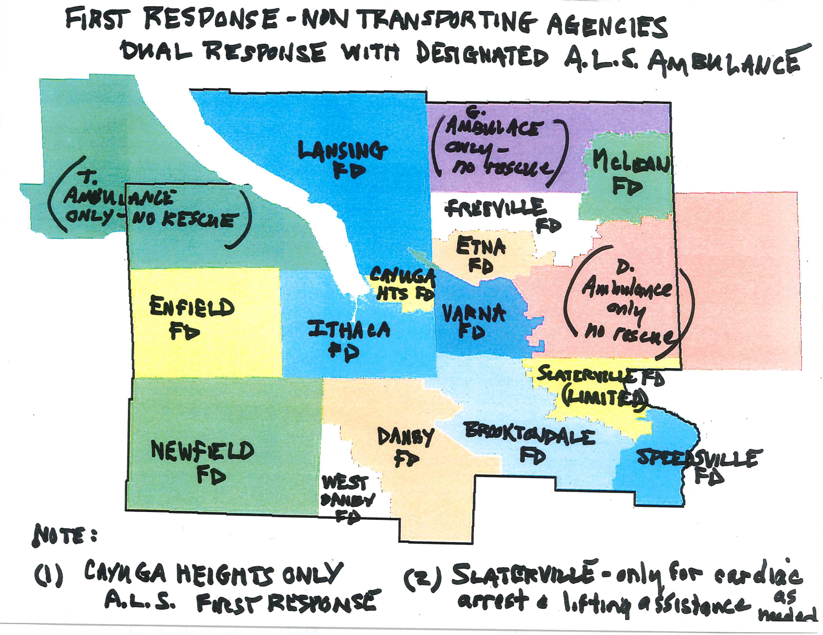

Slide 6
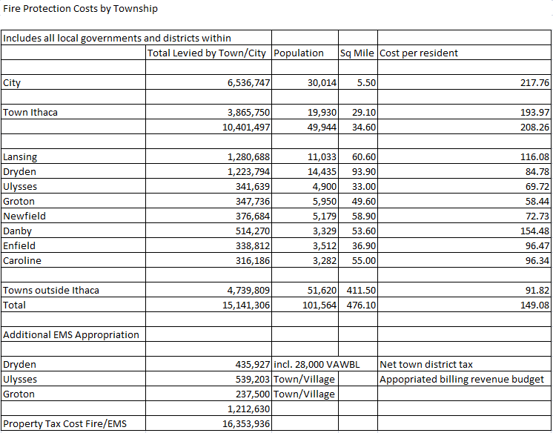
Fire Protection Costs by Township

Slide 7
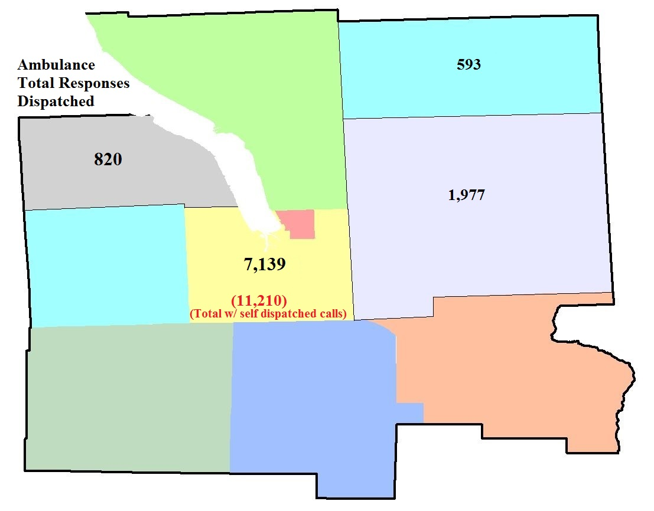
Ambulance – Total Responses Dispatched

Slide 8
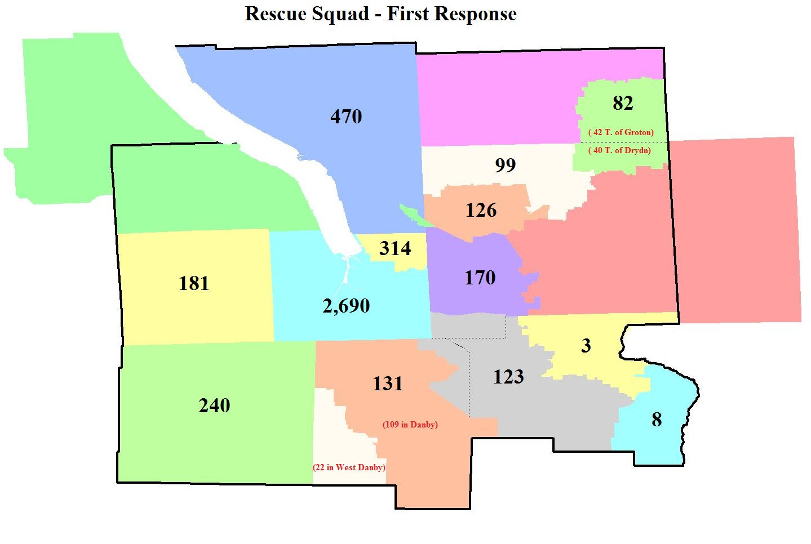
Rescue Squad – First Response

Slide 9

FIRE RESPONSE TRENDS

Slide 10
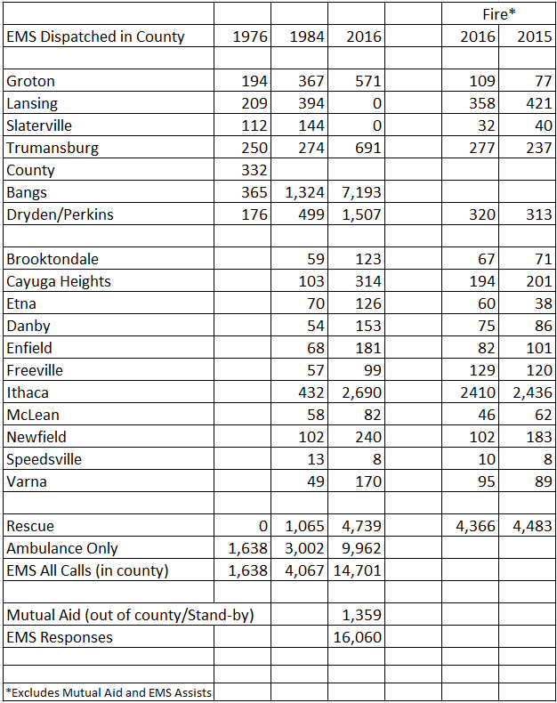
EMS DISPATCHED IN COUNTY

Slide 11
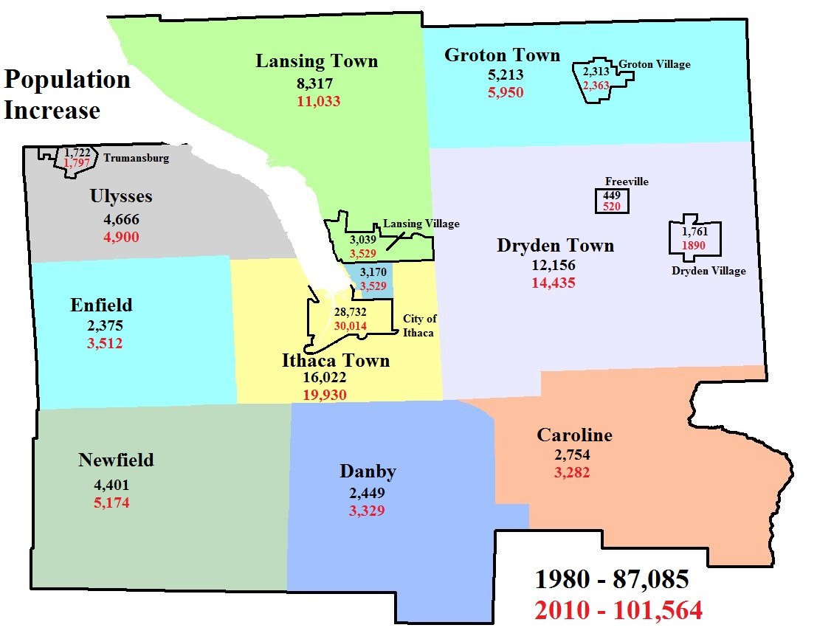
POPULATION INCREASE

Slide 12
AGE DEMOGRAPHICS

Slide 13
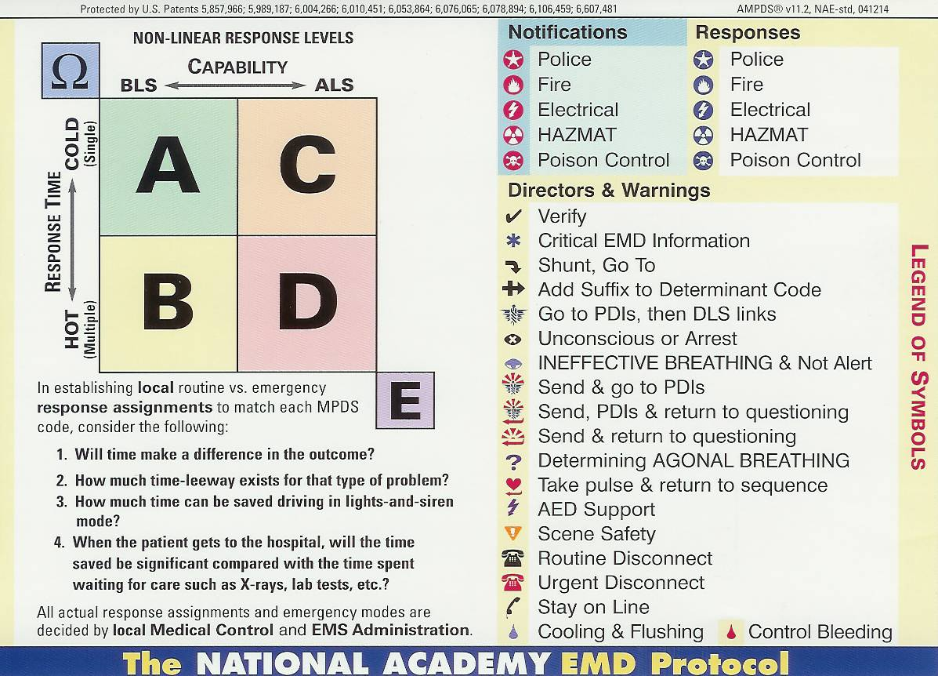
EMD DETERMINANTS
9886 – Ambulance calls dispatched in County and preliminarily coded
7564 – processed by Dispatch as full PRO-QA
1173 – “send”
1149 – taken by 3rd party, assist, fire,
standby

Slide 14
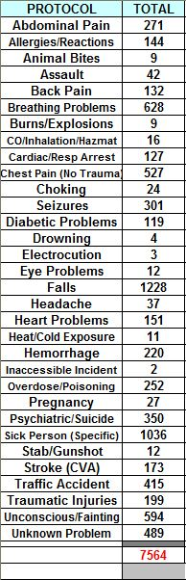
CALLS BY PROTOCOL

Slide 15

FALLS in 2016 – 1,228
Of note: 399 or 32.5% of all calls occurred in a “congregate” living site … and almost half of that number occurred in one site

Slide 16

PROTOCOL 31:
UNCONSCIOUS PERSON

Slide 17
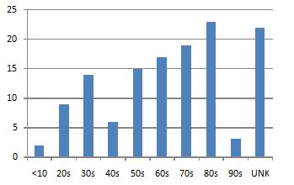
2016 – ECHO CALLS

Slide 18
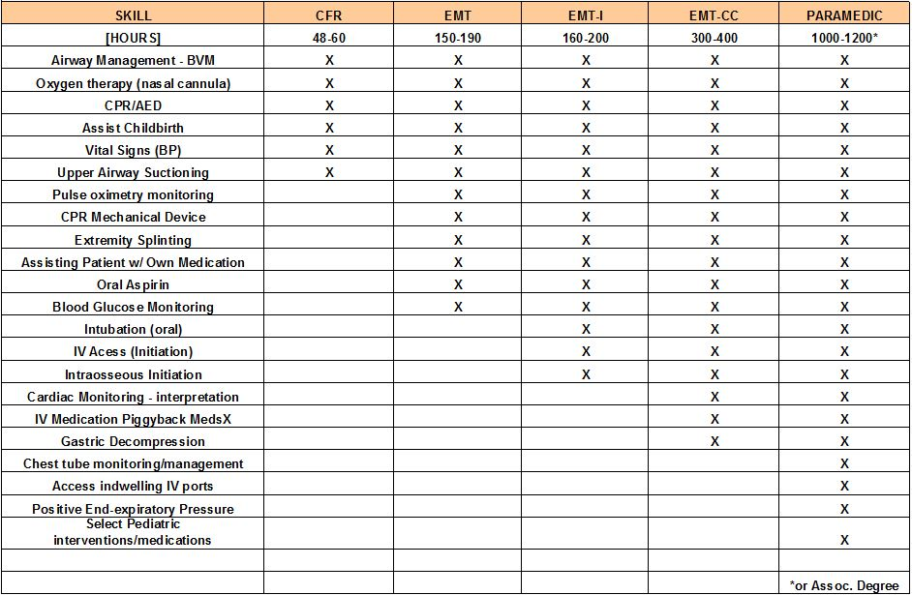
Scopes of Practice

Slide 19
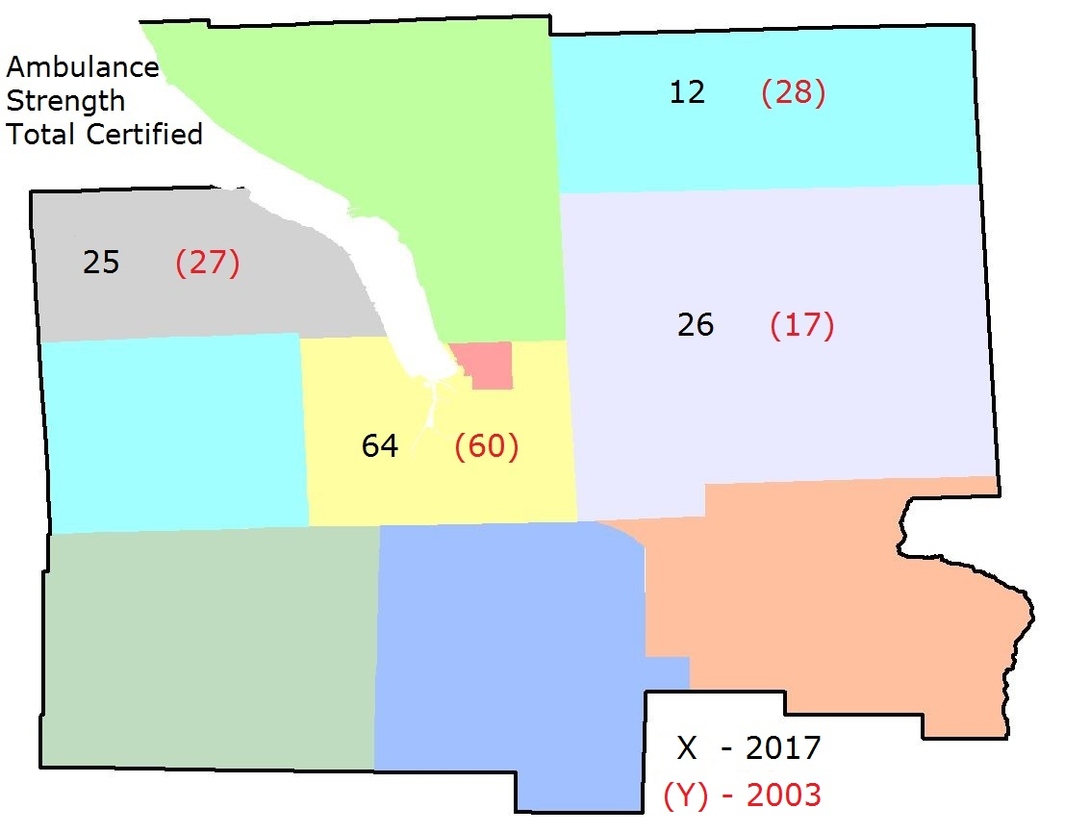
Ambulance Strength – Total Certified

Slide 20
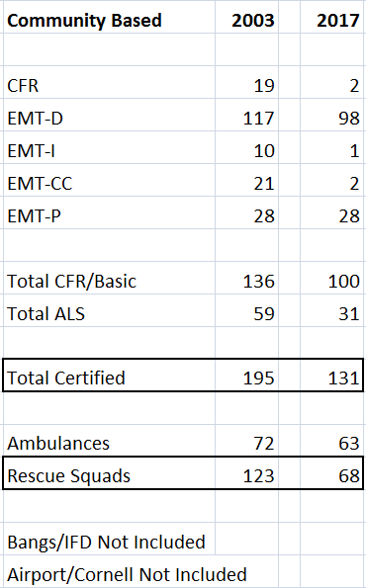
First Response EMS Certification Levels

Slide 21
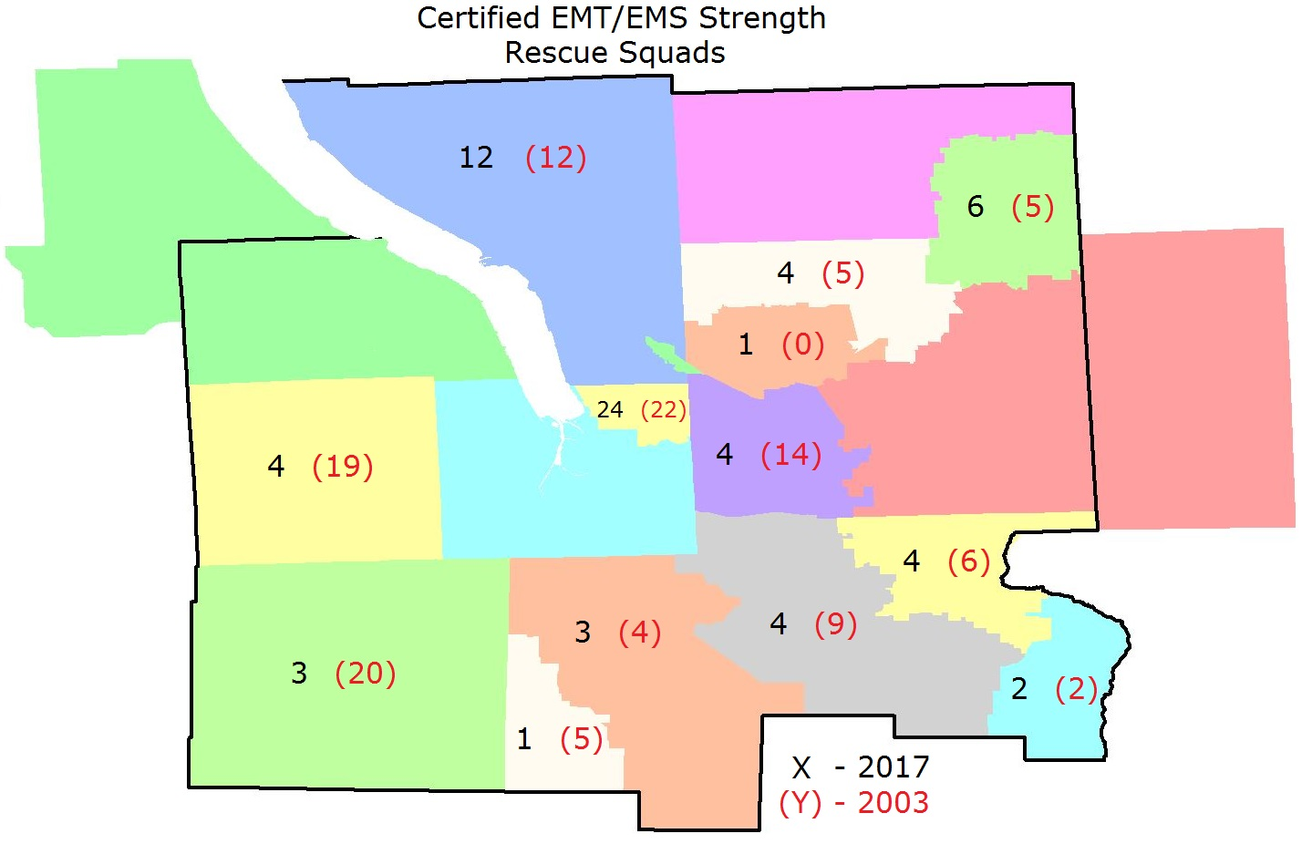
Certified EMT/EMS Strength:
Rescue Squads

Slide 22
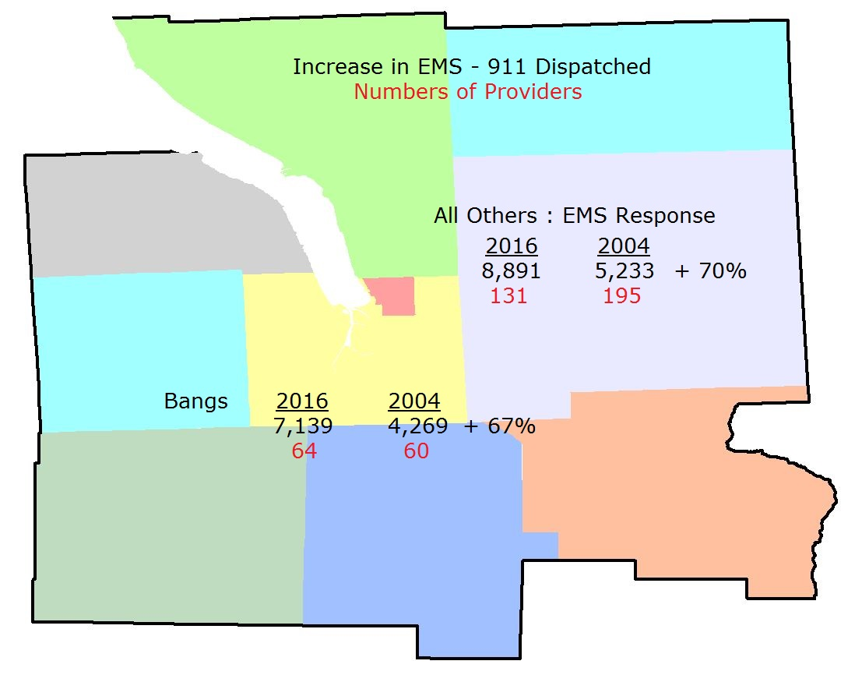
Increase in EMS – 911 Dispatched
Number of Providers

Slide 23
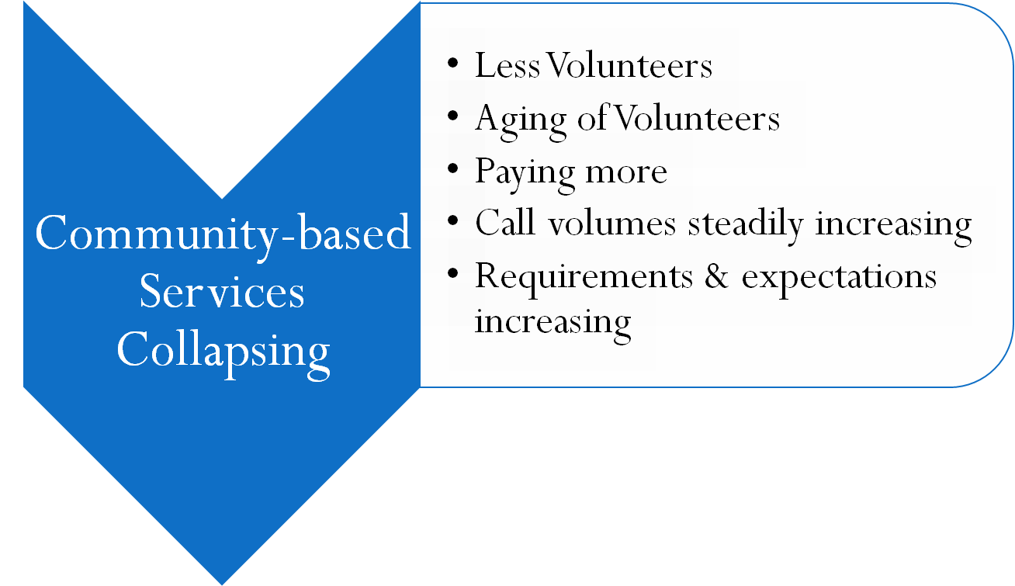
Concerns:

Slide 24
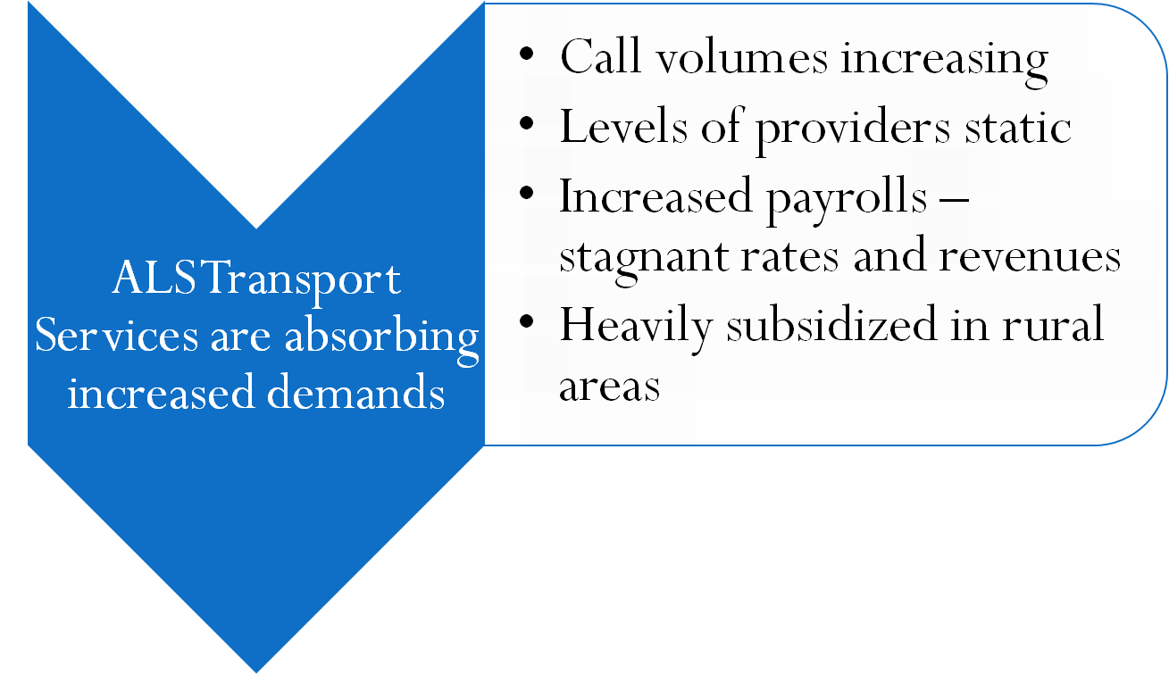
Concerns:

Slide 25
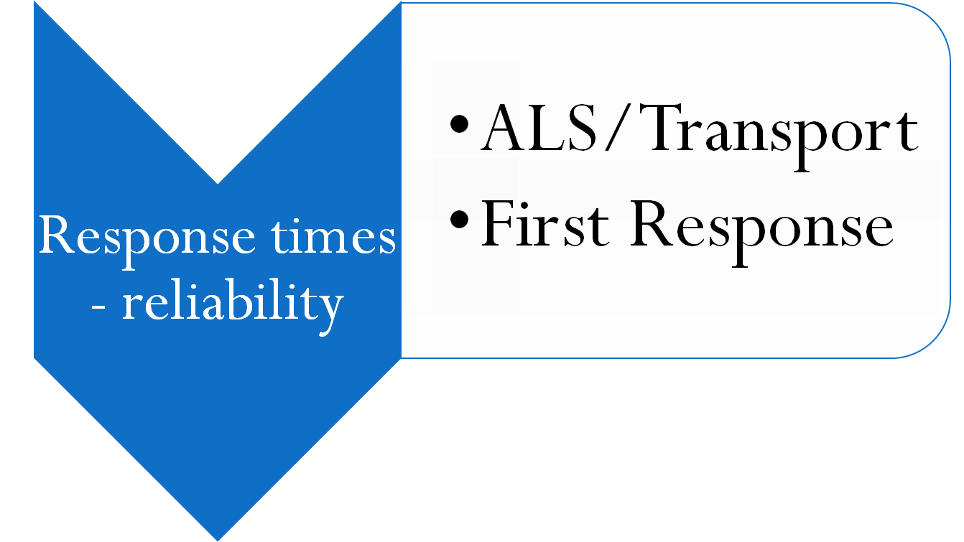
Concerns:

Slide 26
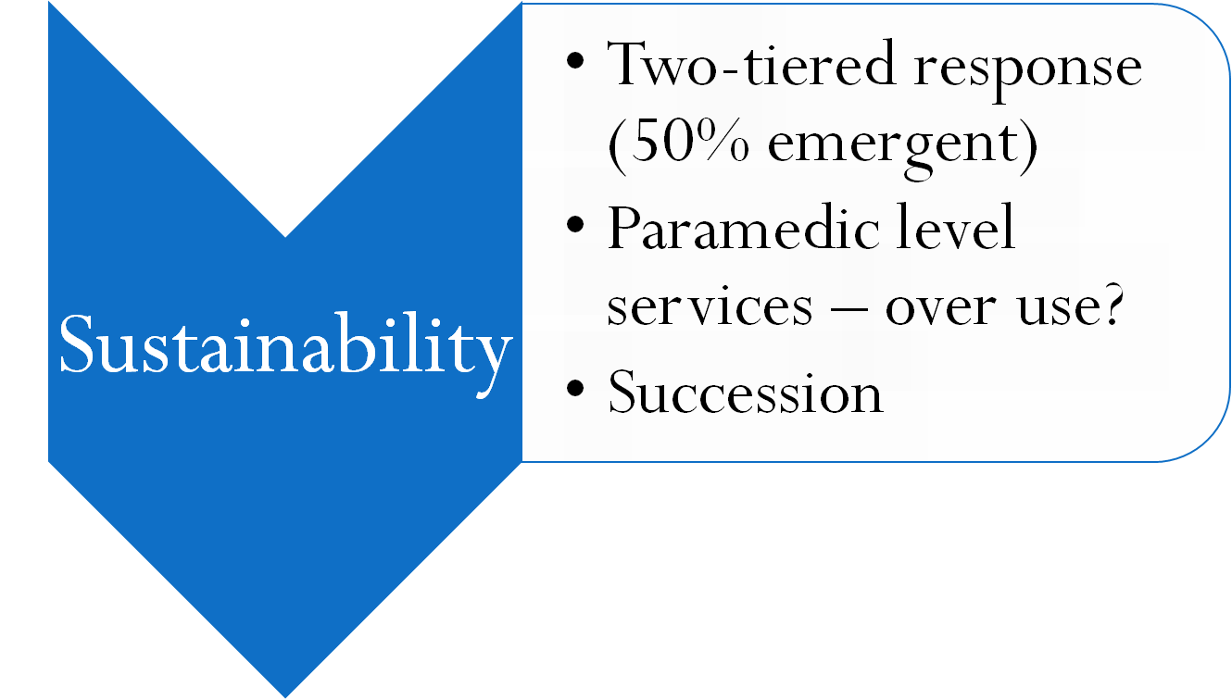
Concerns:

Slide 27
Is there a means to reduce call volumes:
Falls/elderly
Substance abuse
Mental Health
Leverage health care initiatives (readmissions - DSRIP)
Community Paramedicine (mobile integrated health care)

Slide 28

EXPECTATIONS:
Have we defined them?
Are we meeting them?
Can we sustain the EMS system “as is”?

Slide 29

Discussion:

